Slide 1
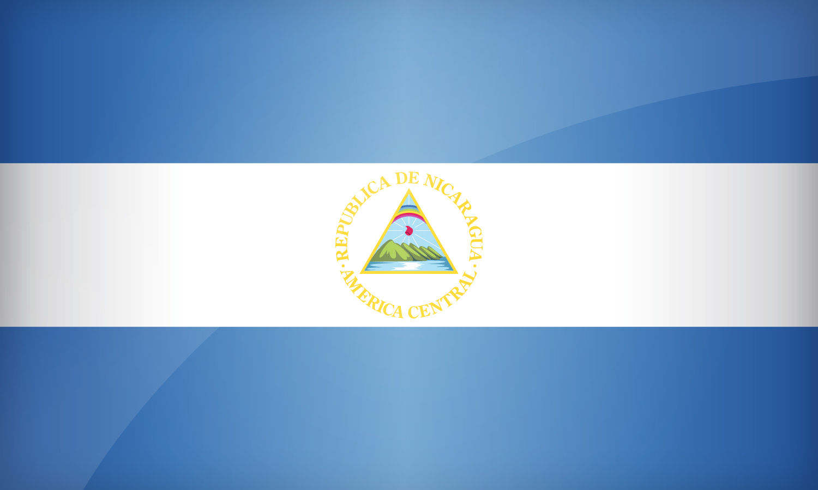
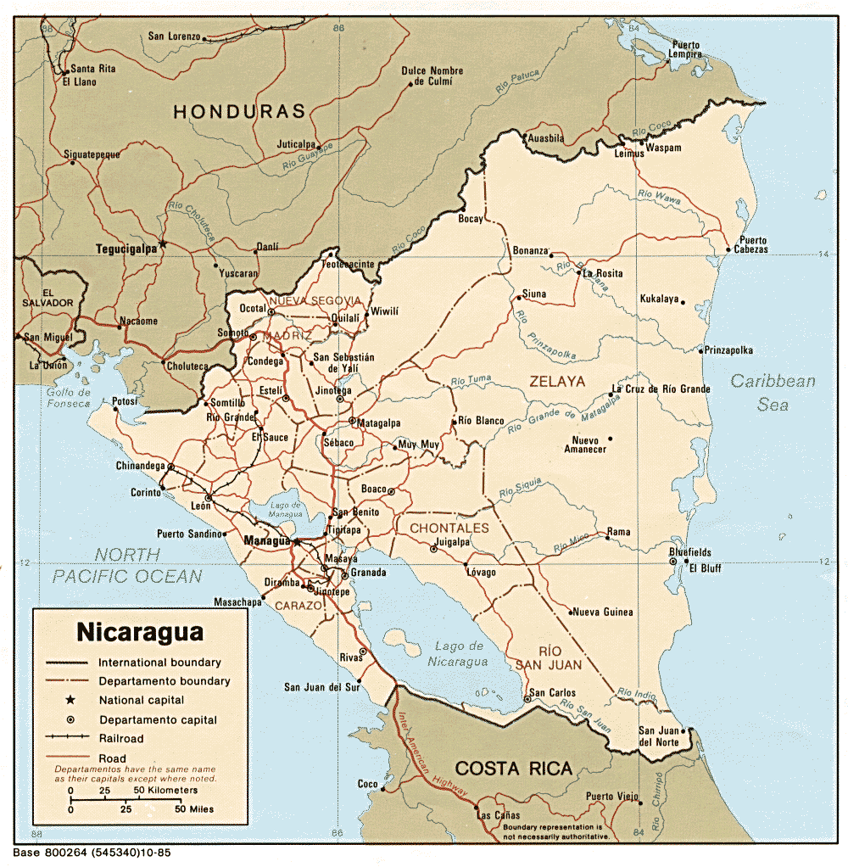
Population: 6.2 million as in 2016
Capital: Managua
Population of Managua: 2.2 million as in 2015
Sites of Interest: Corn Islands, Our Lady of Grace Cathedral, and the Chocoyero-El Brujo Natural Reserve
Currency: Nicaraguan Córdoba, the exchange rate is 1 Nicaraguan Córdoba is 0.03 of a dollar.
Chief Products: Gold, Tobacco, and Sesame Seeds
A major historical event is, Christopher Columbus discovered Nicaragua in 1502, but people moved into Nicaragua in 1522.
Nicaragua Flag:
Nicaragua Map:
Climate: Tropical
Traditional Customs: Beans and corn

